Slide 1





Impact of AI on Zola Wedding company
Market Research
Presentation
Prof. Pedro Oliveira
Kjubra Menga 20230151
Buket Danis 20230152
Dina Konicanin 20231025
Muhammet Emin Imir 20231378
Tausif Ahmad 20231030
Lisbon, 2024

Slide 2


Content
01
02
03
04
05
Research Problem Definition
Research
Design
Data
Collection
Data
Analysis
Communicate
the Results

Slide 3

Projects Overview: Zola’s Journey
ABSTRACT
APPROACH
The impact of generative AI on the “Zola Wedding Platform’s ability to optimize customer engagement and business performance in the wedding planning market.
Two-step strategy;
1) understand AI's role in empowering SMBs.
2) Impact of generative AI on customer engagement and overall business performance for Zola Weddings.

Slide 4
Research Problem Definition
Research Objectives
Personalizing and streamlining the wedding planning experience
Improving customer communication and feedback
Research Questions
How can AI streamline business operations and reduce operating costs for Zola.com?
How can generative AI improve customer engagement and retention rates for Zola.com?

Slide 5

Case Background: Zola’s Journey
Prior to Zola's emergence in 2013 (founded by Shan-Lin Ma and Nobu Nakaguchi), the wedding industry offered a limited and outdated approach to wedding registries.
The key features of Zola's registry include;
Group gifting
Allowing guests to contribute to larger, more significant items like honeymoons or home improvements.
Delivery scheduling
Allowing couples to schedule gift arrival according to their timeline.
Experiences over possessions
Giving guests the option to contribute to the couple's dream honeymoon instead of material gifts.

Slide 6

Zola's Business situation: navigating the Covid 19 pandemic
Zola Business Situation
Disaster (COVID 19):
How Zola Figured Out:
Accelerated use of digital and AI tools (e.g., digital invitations)
Surge in wedding postponements and cancellations

Slide 7
Zola's Business situation: navigating the Covid 19 pandemic
AI-Powered Chatbot: Split the Decisions
AI Integration into Zola's Business
Launched "Split the Decisions," a free AI-powered chatbot that helps couples assess their strengths and tasks accordingly
Uses AI for customer service, fraud detection, and other internal functions

Slide 8
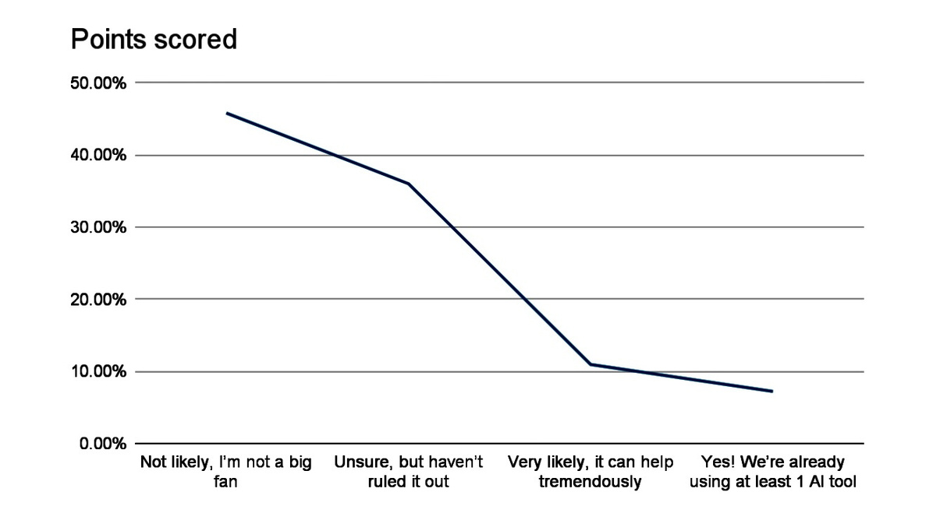
Secondary Data Analysis
(Source: Insight from the 2024 Wedding Trends Survey)
Are you using, or considering using, any AI tools to support your wedding planning?
45.82% - Not likely, I’m not a big fan
36.02% - Unsure, but haven’t ruled it out
10.95% - Very likely, it can help tremendously
7.22% - Yes! We’re already using at least 1 AI tool

Slide 9

Secondary Data Analysis
The report "Wedding Services Market Size by Type (Local Wedding, Destination Wedding), Regions, Global Industry Analysis, Share, Growth, Trends, and Forecast 2023 to 2032"
The global wedding services market is expected to grow at a rate of 13.74% from 2023 to 2032, reaching a projected market size of USD 178.46 billion in 2022.
The Indian wedding industry is expected to reach a value of over USD 50 billion by 2025 and the US wedding industry is expected to grow at a (Compound Annual Growth Rate) CAGR of 4.5% from 2023 to 2032.

Slide 10
Secondary Data Analysis
Website blog
Press
Trends and Insights
The company's market performance can be analyzed through growth figures, user base statistics, and
partnerships on its market position and success within the wedding industry.
Zola's blog webpage is a valuable source of secondary data on wedding trends for 2024.
Artificial Intelligence (AI) is officially landing in weddings, with couples embracing tech.

Slide 11
Literary Overview
Zola's Adoption of AI: (Susana C. Santos, et al., 2023) Zola has introduced AI-powered tools, such as Lang and "Split the Decisions," to streamline the wedding planning process and provide personalized solutions.
Growing Use of AI in Wedding Planning: (Jannik Lindner, 2024) The wedding industry has seen significant growth in the use of AI, with 80% of couples using at least one AI-powered tool during their wedding planning.
Challenges and Drawbacks: (Natali Grace Levine, 2023) Some small and medium-sized businesses lack IT support and understanding, and may face challenges in adopting AI.

Slide 12
Hypothesis Map
H1: Personalized Wedding Planning
H2: Customized Wedding Invitations
HOW AI IMPACTES THE ZOLA?
H3: Virtual Reality Wedding Planning
H4: Intelligent Wedding Photography

Slide 13

Research Design
Type of Research
Measurement and Scaling
Online Survey Qualtrics
Nominal Scale
Likert Scale Measurement
Conclusive
Ordinal Scale
Interval Scale
Descriptive - Cross Sectional

Slide 14

Sample Process and Sample Size
Data Collection Method
Non Probability
Primary Data Collection
Convenience Sample
Snowball Technique
70 respondent for Online Survey
Relation to Marriage
Distributing Channels

Slide 15
Plan For Data Anaiysis
01
Hypoth﻿eses
02
Dataset
General research topic consist of the regarding to four hypotheses and which ones are indicated as below;
This analysis utilizes a survey dataset collected to explore adult perspectives on the role of Artificial Intelligence (AI) in wedding planning.
The data represents the responses of a sample population of adults regarding their experiences with online wedding planning tools and their attitudes towards AI integration in various aspects of the wedding planning process.
H1: Personalized Wedding Planning
H2: Customized Wedding Invitations
H3: Virtual Reality Wedding Planning
H4: Intelligent Wedding Photography

Slide 16
Plan For Data Anaiysis
Variables to used in the main analysis
03
Exposure Variables: Ever Used Zola or Similar Platform (H1): This binary variable (Yes/No) indicates whether the participant has prior experience with online wedding planning platforms.
Main Outcome Variables: This analysis focuses on several key outcome variables that shed light on adult perspectives on AI in wedding planning. These variables capture participants' attitudes, beliefs, and intentions regarding AI's role in various aspects of the planning process;
Attitudes towards Online Platforms and AI Integration
Beliefs about AI Personalization and Planning
Perceptions of AI for Wedding Day Tasks
Openness to AI-Powered Photography
Stratifying Variables: Age, Gender,Marital Status.

Slide 17
Plan For Data Anaiysis
04
05
Statistical methods and software
06
Inclusion / Exclusion Criteria
Key Table Shells
SPSS as a giant toolbox filled with statistical analysis equipment. We'll be using this toolbox to unlock the insights hidden within our survey responses.
Adults (age 18+)
Those who are currently planning their wedding or have been married in the past.
VS
Individuals under 18 years old
Those who do not fall into the target audience (planning/married).
Summarize the data for different aspects
of the survey.
In SPS we will focus descriptive, explore and correlation analysis. These sections (Data View, Analyze) provide the necessary tools to analyze our data for demographics, normality tests, and hypothesis testing related to H1 (Personalized Wedding Planning).
06

Slide 18

Key Table Shells of Zola
 | d | * Mean (SD) for: * Comfort with AI Logistics (H3) (Categorical scale) * Cost Savings with AI (H3) (Categorical scale)
TABLE
DESCRIPTION
VARIABLES
Compares how people who have never
used online planning tools view AI in
wedding planning compared to those
who have used them (H1).
*Used Online Platform (H1) (Yes/No)
* Importance of AI in Planning (H1) (Likert scale)
* AI Reduces Stress (H1) (Likert scale)
* Likely to Use Online Platform (H1) (Likert scale)
Online Platforms vs.
AI Views (H1)
* Mean (SD) for:
* Customized Wedding Ideas (H2) (Likert scale)
* Unique Weddings with AI (H2) (Likert scale)
* AI for Wedding Schedule (H2) (Likert scale)
Beliefs about AI Personalization
(H2)
Summarizes average responses on AI
personalizing weddings (H2).
Comfort & Cost Savings with AI (H3)
Summarizes average responses on
AI's role in the wedding day (H3).

Slide 19
Key Table Shells of Zola
 | Summarizes average responses on AI photography (H4). | * Mean (SD) for: * AI-Powered Cameras (H4) (Likert scale) * Capturing Emotions with AI (H4) (Likert scale) * Satisfaction with AI Photography (H4) (Likert scale)
 |  | * Age (Years) * Gender (Male/Female/Other) * Marital Status (Currently Planning/Considering Planning/Married/Not Considering Planning)
TABLE
DESCRIPTION
VARIABLES
AI Cameras & Capturing Emotions (H4)
Demographics
Shows the breakdown of participants
by background factors.

Slide 20
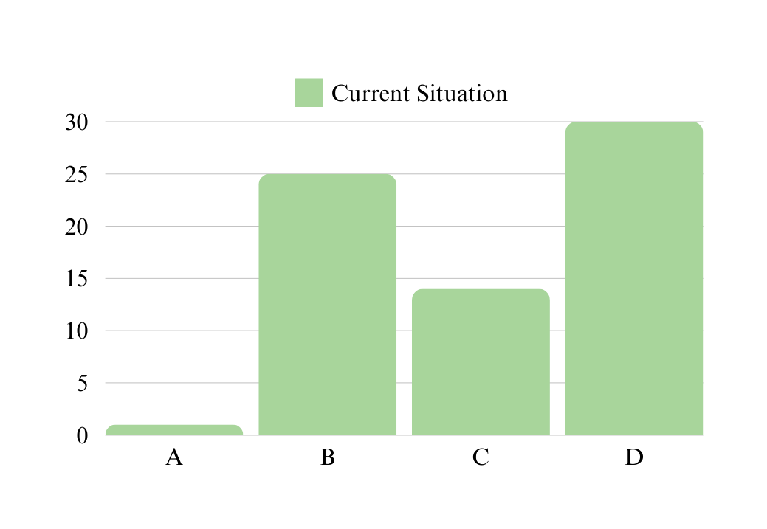
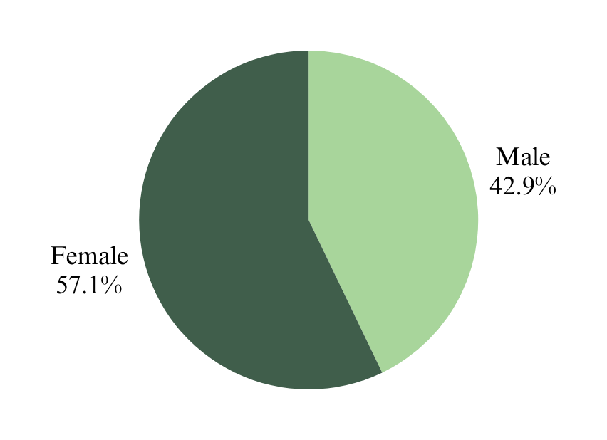
Data Analysis
Questionnaire and Findings - demographics
PLAN FOR DATA ANALYSIS
Wedding plans
A ) 1.4% of respondents are currently in the wedding planning process.
B ) 35.7% of respondents are considering planning a wedding in the near future.
C ) 20% of the participants are married.
D )42.9% of respondents are not currently planning a wedding.
42.9% of the participants are male.
57.1% of the participants are women.

Slide 21
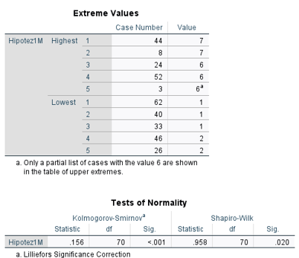
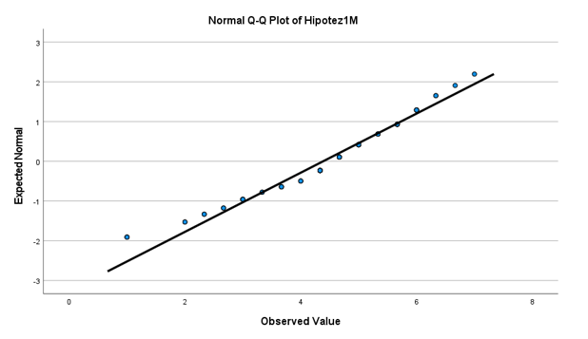
Data Analysis
Normality distribution test
PLAN FOR DATA ANALYSIS
Our Significant value is less than 0.05. In this case, we can say that there is no normal distribution. At the same time, this situation also shows us that my hypothesis is correct. We used Spearman when analyzing.

Slide 22
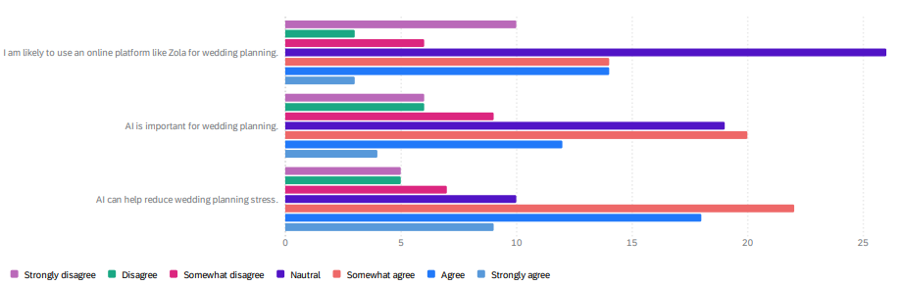
Data Analysis
Plan for Data Analysis
The chart provides evidence that online wedding planning platforms and artificial intelligence are becoming increasingly popular in wedding planning. Couples can turn to online platforms and artificial intelligence to plan their wedding, as these tools can streamline the process and reduce stress.

Slide 23
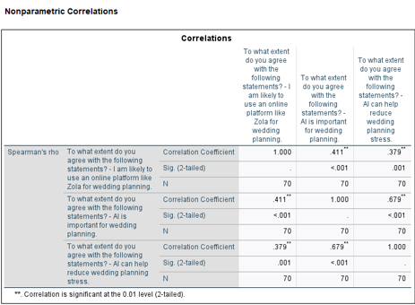
Data Analysis
Correlation Analysis
PLAN FOR DATA ANALYSIS
We analyzed the correlations between Hypothesis 1 variables.
In general, there is a positive correlation between variables. There is a very strong positive correlation between the Important and Stress variables.
These results show us that Hypothesis 1 is correct. At the same time, People in the study believe Al makes wedding planning easier and reduces stress. This suggests that Al may be popular with wedding planners.
LIKE
IMPORTANT
STRESS

Slide 24
Conclusion
Personalized Wedding Planning (H1)
Highlights key points from findings related to H1 and online wedding planning platforms;
Strong correlations between positive views on AI and likelihood of using online platforms.
Importance of considering the perspective of wedding planners.
Potential market for AI-powered wedding planning tools.

Slide 25
Conclusion
Experience
The study found exciting connections! People who believe AI makes planning easier are more likely to use online platforms like Zola. This suggests a potential boom for AI-powered planning tools!

Slide 26
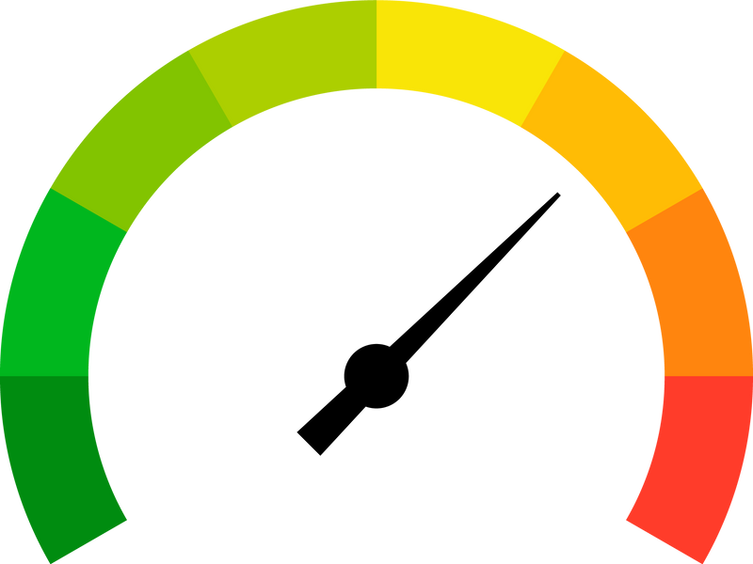
Research Limitations
While AI is making a big splash in the wedding industry, there are some limitations to its impact on wedding platforms:
Data Bias: If the data used to train the AI is biased, the recommendations it makes could be skewed.
Lack of Human Touch: AI can't replace the creativity and emotional intelligence of a human wedding planner.
Privacy Concerns: AI platforms that collect a lot of data about couples raise privacy concerns.
Ethical Considerations: There are ethical considerations around AI-generated content, such as photos or videos.
Method Limitations;
Potential response bias in survey.
The generalizability of conclusions from quantitative research may be impacted by its shallowness, rigidity, and narrow scope.
Brief time spent studying.
Small sample size, unfocused country and income informations of participants.

